Slide 1
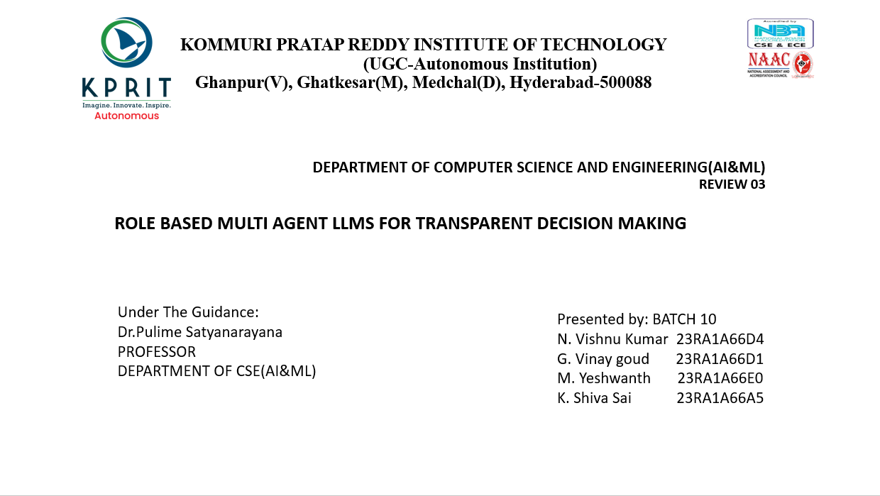

Slide 2
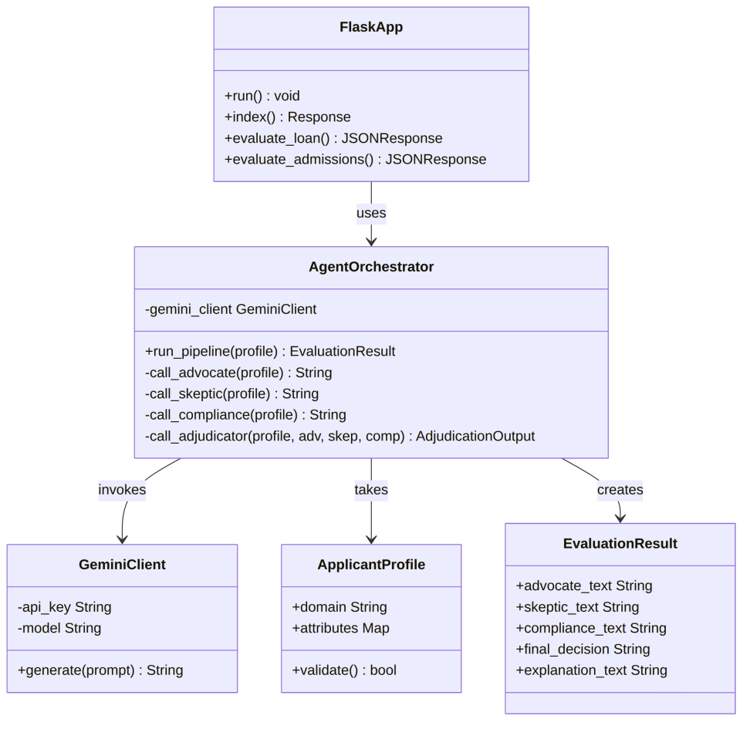
5.1 Class Diagram
FlaskApp handles HTTP requests and delegates to AgentOrchestrator
AgentOrchestrator validates data via ApplicantProfile and runs the four agent stages
GeminiClient calls the Gemini API
EvaluationResult holds the agent outputs, final decision and explanation

Slide 3
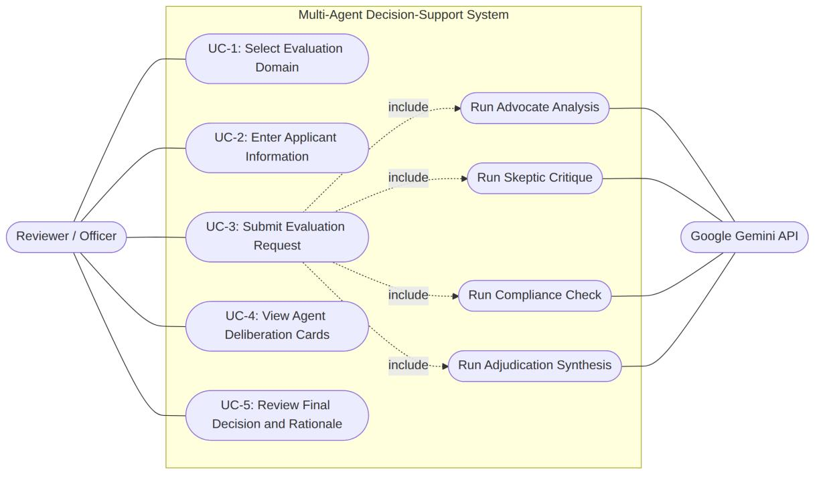
5.2 Use Case Diagram
Actor: Reviewer / Officer
Select domain, enter applicant information, submit request
View agent deliberation cards, review final decision and rationale
Google Gemini API runs advocate, skeptic, compliance and adjudication

Slide 4
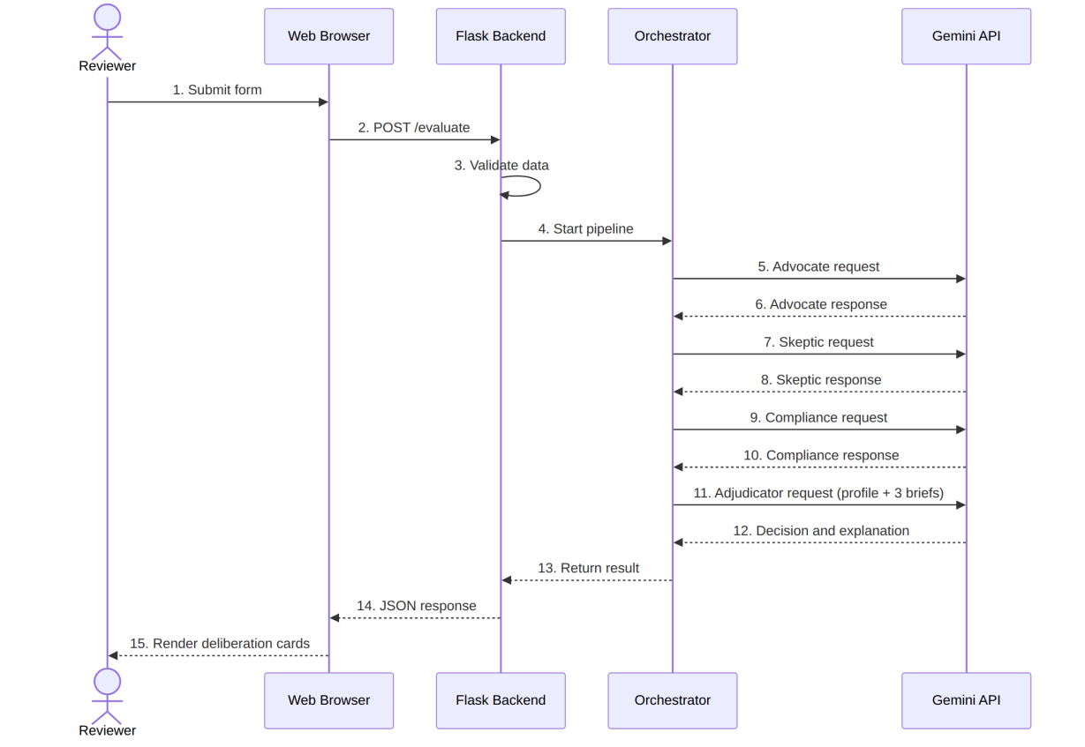
5.3 Sequence Diagram
Reviewer submits form; POST /evaluate; Flask validates data
Orchestrator calls Gemini in order: Advocate, Skeptic, Compliance
Adjudicator receives profile + 3 briefs and returns decision
JSON response is rendered as deliberation cards

Slide 5
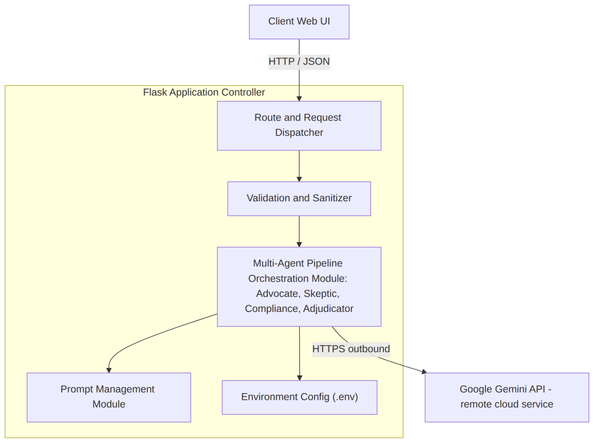
5.4 Component Diagram
Route dispatcher, validation and sanitizer
Multi-agent orchestration module
Prompt management module, environment config (.env)
High cohesion and loose coupling

Slide 6
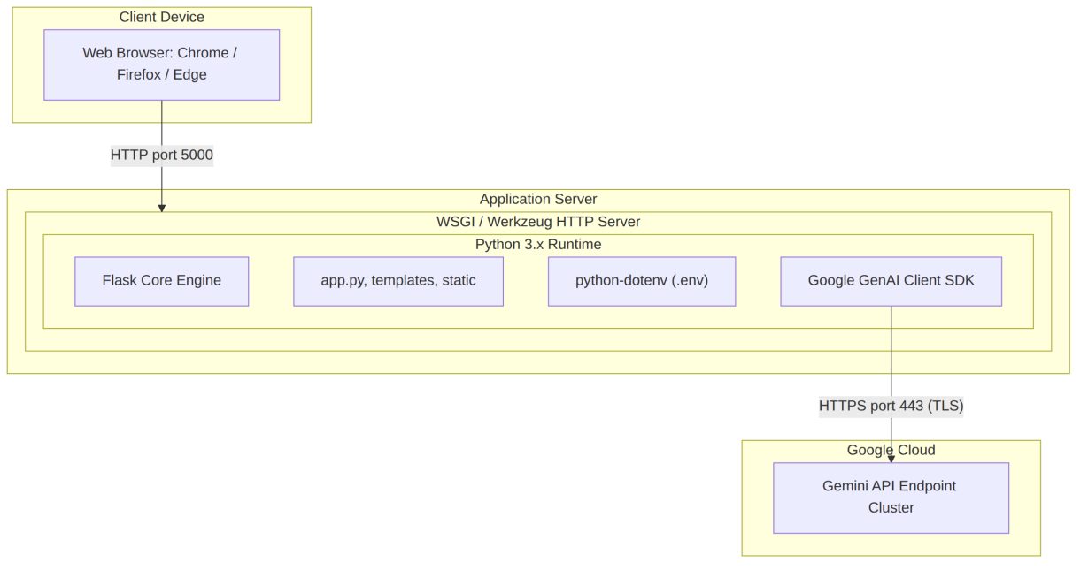
5.5 Deployment Diagram
Browser connects to Flask server over HTTP port 5000
Server runs Python 3.x with Flask, python-dotenv and GenAI client SDK
Connects to Gemini API on Google Cloud over HTTPS port 443

Slide 7
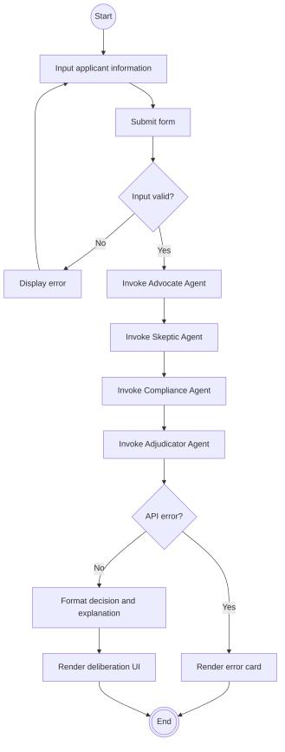
5.6 Activity Diagram
Input applicant information and submit form
If input is invalid, show error and return to input
If valid, invoke Advocate, Skeptic, Compliance, Adjudicator in order
On API error show error card; otherwise render deliberation UI

Slide 8
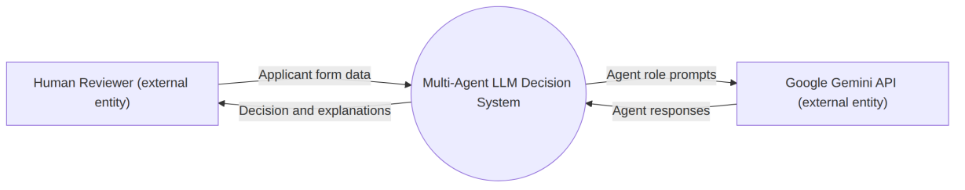
5.7.1 DFD Level 0 (Context Diagram)
External entities: Human Reviewer and Google Gemini API
Reviewer sends applicant form data and receives decision and explanations
System sends agent role prompts to Gemini and receives agent responses

Slide 9
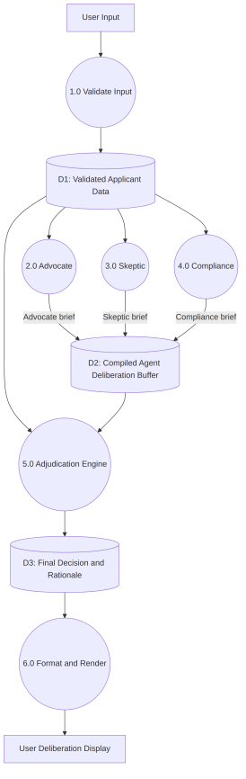
5.7.2 DFD Level 1 (Decomposed Process)
1.0 Validate input stores data in D1
2.0 Advocate, 3.0 Skeptic, 4.0 Compliance produce briefs stored in D2
5.0 Adjudication Engine stores result in D3
6.0 Format and Render shows output to the user

